Slide 1

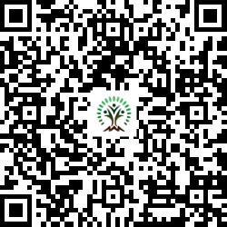


IONIQ Forest
Grid – H Zones 1 -10

Slide 2
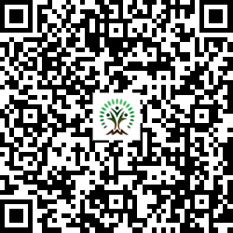
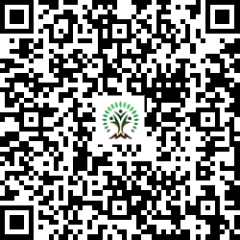
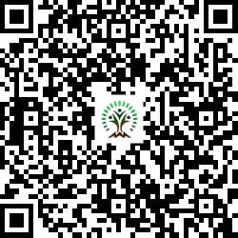
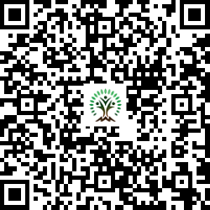
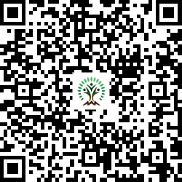
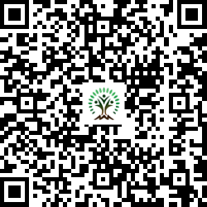
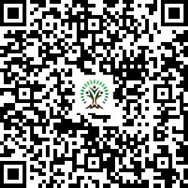
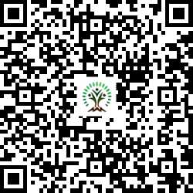
Sr. No. | Scientific Name | Common Name | QR Code
1 | Azadirachta indica | Neem Tree
2 | Dalbergia sissoo | Indian rosewood
3 | Mimusops elengi | Spanish cherry
4 | Neolamarckia cadamba | Burrflower tree
5 | Pongamia pinnata | Indian Beech Tree
6 | Syzygium cumini | Java plum, Jamun
7 | Terminalia arjuna | White Murdah
Sr. No. | Scientific Name | Common Name | QR Code
8 | Toona ciliata | Indian mahogany

